Slide 1
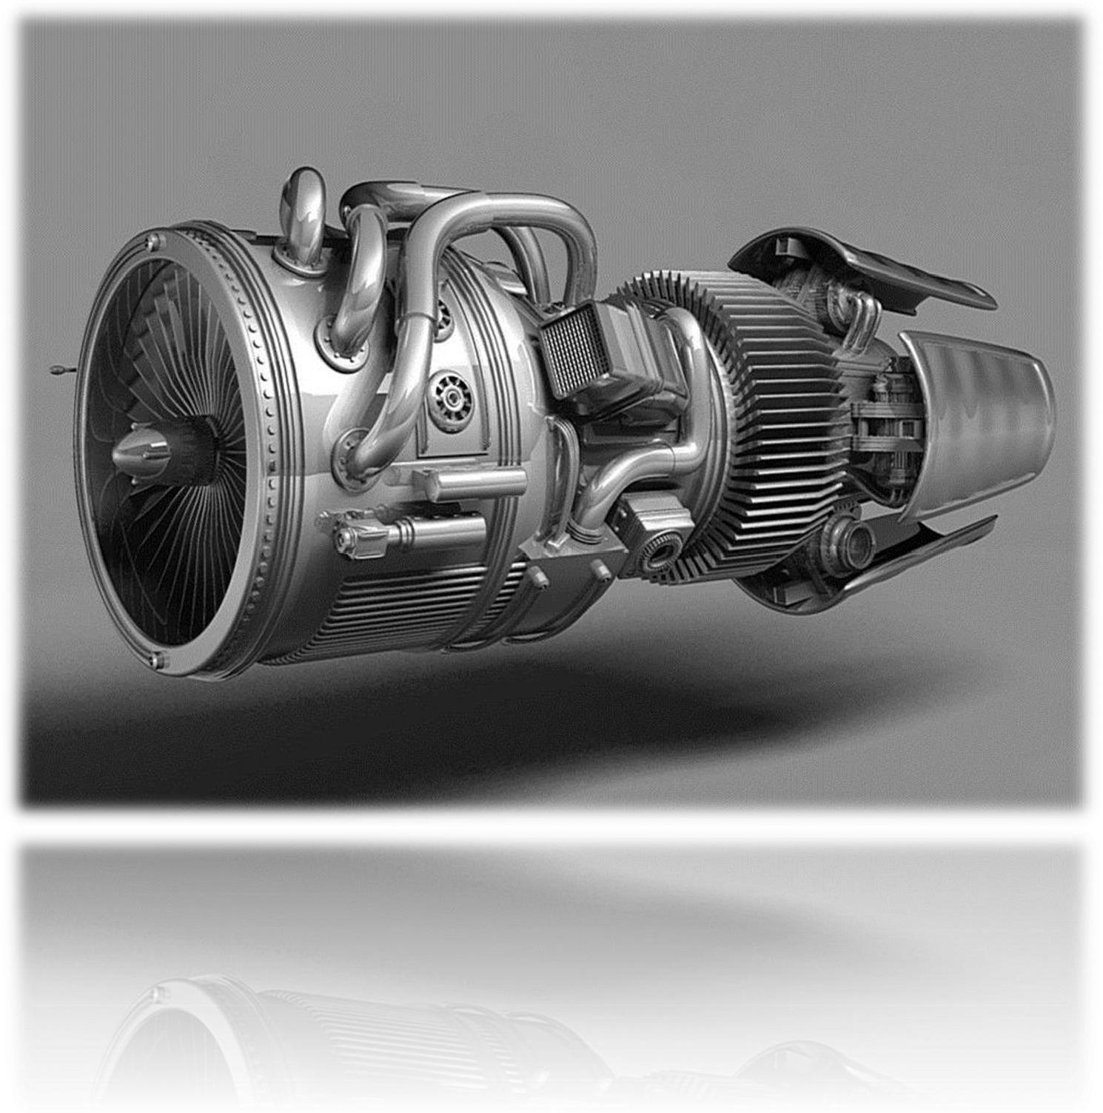
EBL Coursework
MECH32102
2024-2025

Slide 2
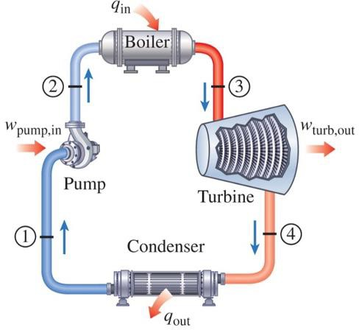
Introduction
The majority of electricity power generation uses various refinements of the Rankine cycle.
The coursework is an Enquiry-Based Learning (EBL) exercise.
Groups are tasked with developing, optimising, and assessing two competing variants of the Rankine cycle in addition to a research task (Part B):
Superheated Rankine cycle with reheat.
Superheated regenerative Rankine cycle with a single open feed water heater.
Figure 10–2
The simple ideal Rankine cycle.
Designs are assessed in terms of cycle efficiency and specific work output.

Slide 3
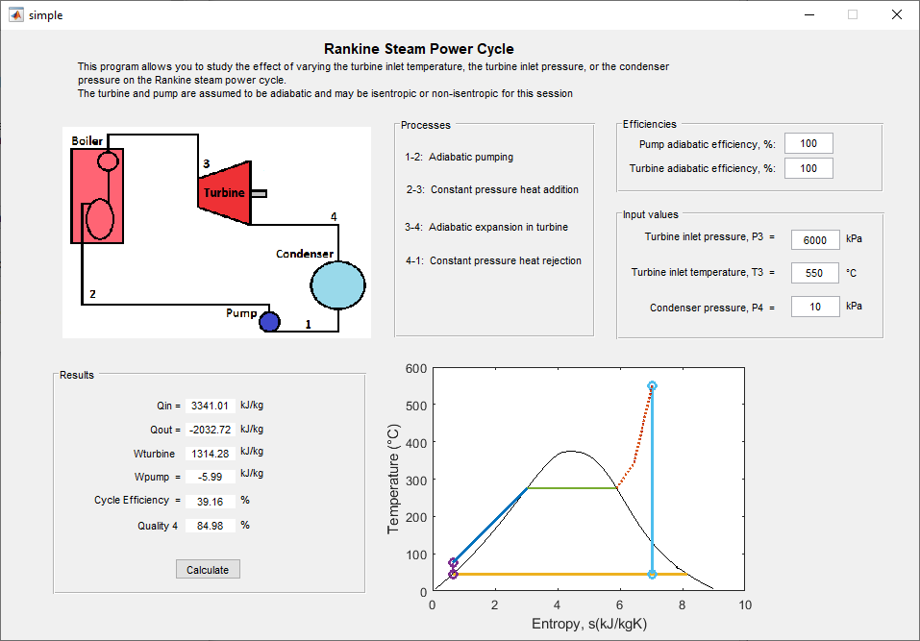
Overview of Activity
Groups should:
Research the topics relating to Rankine cycles:
Rankine cycle with reheat, regenerative Rankine cycle, isentropic efficiency, pactical limits on plant operation.
Conduct an optimization exercise using a MATLAB software
package called SPOWER.
MATLAB is available to download and install on personal computers: see here.
SPOWER is available on Blackboard
Figure
SPOWER interface

Slide 4
Overview of Activity
Groups should:
Conduct an optimization exercise using a MATLAB software
package called SPOWER.
GTA’s will provide demonstration on the use of SPOWER.

Slide 5
Group arrangements
Group lists are available on Blackboard.
Groups should be formally organized.
Nominate a chair and minute taker.
Hold at least formal 3 meetings.
Minutes should, at a minimum, include:
Attendance and engagement of all members
Follow up on previous actions.
Progress
The allocation of further tasks (actions)

Slide 6
Sessions
Two sessions are arranged. Attendance is compulsory at both.
Week 6: SPOWER demonstration
Each group is assigned a GTA who will provide demonstration in SPOWER.
Provide details on the exercise.
Date: 3 March 2025
Time: 15:00-16:00
Location: George Begg Bld (B7 Computer room)
Tutor | Groups
Dae Yeob Lee | 1 | 2 | 3 | 4 | 5
Sumanta Laha | 6 | 7 | 8 | 9 | 10
Yihe Yu | 11 | 12 | 13 | 14 | 15

Slide 7
Sessions
2. Week 9: EBL Q&A
A “Q&A” session with your allocated GTA.
Provides an opportunity for the GTA to check your progress and answer any questions you may have.
Groups are not formally assessed during this session.
Check your typical turbine and pump operating conditions (pressure, temperature, efficiency) to start the optimization of both cycles.
Date: 24 April 2025
Time: 15:00-16:00
Location: George Begg Bld (B7 Computer room)
Session Time | 15:00-15:12 | 15:12-15:24 | 15:24-15:36 | 15:36-15:48 | 15:48-16:00
Dae Yeob Lee | 1 | 2 | 3 | 4 | 5
Sumanta Laha | 6 | 7 | 8 | 9 | 10
Yihe Yu | 11 | 12 | 13 | 14 | 15

Slide 8
Where to go
George Begg Bld
(B7 Computer room)
Groups should only attend at their allocated time.
Each GTA will setup in the cluster at the approximate location.
You do not need to log in.
Attendance will be taken.

Slide 9
Report
Deadline for report submission:
5pm, Friday 2nd May 2025.
Group chair is responsible for uploading and submitting the report via Blackboard.
Late submissions follow University guidelines.
One report per group, maximum 20 pages (excluding appendix)
Detailed guidelines on sections to include provided in the CW brief. GTA can provide further assistance.
All group members will receive the same mark.

Slide 10
Tips
An Enquiry-Based learning exercise encourages you to ask questions and then to conduct research to explore possible answers.
However, cutting edge research is not needed to achieve the objectives of this EBL.
A guide to the number of hours you should spend on this task is provided in
the Brief.
Practical limits should be properly referenced.
Analysis ‘on paper’ means an analysis similar what you might do to answer a tutorial question. It is not meant literally and the section should be typed up.
Stick to task and the cycles prescribed.
During your research you may come across all kinds of weird cycle variants or novel turbine ideas.
If it’s not necessary to achieve the objectives of the exercise, then consider
whether it needs to be included in your report.

Slide 11
End

